Slide 1
Swiggy Drone Delivery Model
(Revolutionizing Food Delivery With Drones)

Slide 2

About Swiggy:
Founded in 2014,headquartered in Bangalore, India.
Leading online food delivery service in India.
Offers food delivery, grocery delivery(Instamart), and package delivery(Genie).

Slide 3
Why Drone Delivery?
Traffic congestion
Longer delivery times
Higher delivery cost
Advantages of Drone Delivery
Faster delivery times
Reduced operational costs
Eco-friendly and reduces carbon footprint

Slide 4
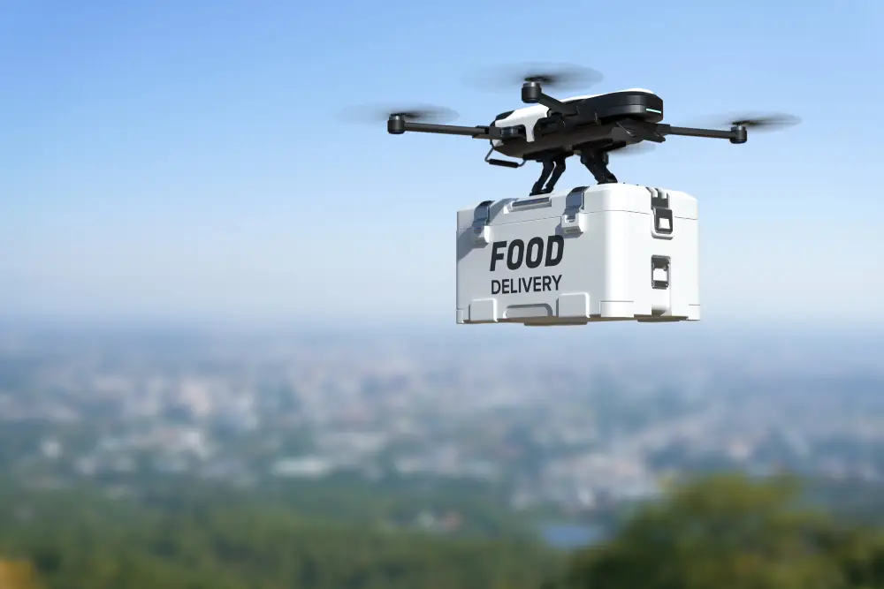
Overview of Drone Delivery Model:
Components:
Drones
Delivery manage system
Drone Pilots
Drone station
Integration with Swiggy app

Slide 5
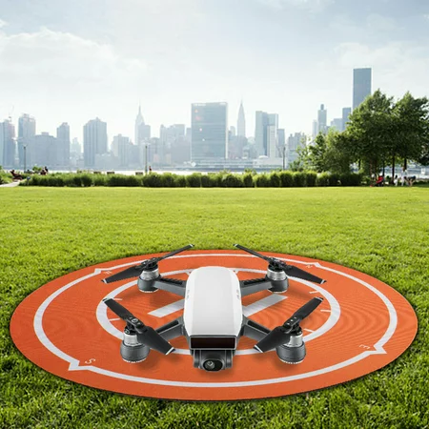
Order processing
Customer places an order via swiggy app.
App suggest drone delivery if eligible.
Restaurants prepares the order as usual.
Order is packed in a drone-compatible container.
Ensuring order accuracy and secure packaging for drone transport.
Drone is loaded with packaged order.
Before flight check battery status, GPS and navigation system calibration and weather conditions.
Drone takes off from a designated hub or restaurant rooftop.

Slide 6
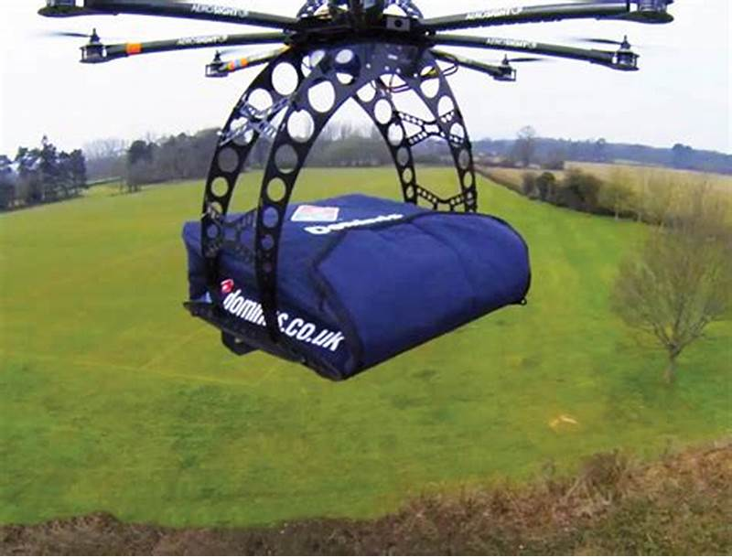
Drone Flight Path and Navigation
Optimized flight path using GPS and real-time traffic data.
Avoids no-fly zones and high-traffic airspace.
Drones ascends to an optimal altitude(150-300ft) to obstacles.
Continuous tracking via swiggy’s delivery management system.
Real time adjustments based on weather and other conditions.
Obstacle sensing in three directions to avoid collisions.

Slide 7
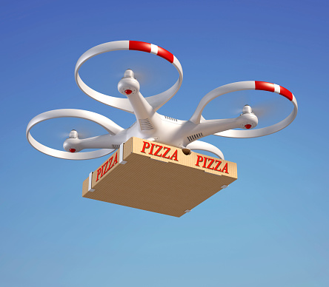
Delivery and Landing
Customer receive notifications with estimated arrival time .
Live tracking available in the app.
Pre-designated secure landing spots near the customer’s location.
Drone lands and releases the package safely.
Customer picks up the order using code or app confirmation.

Slide 8
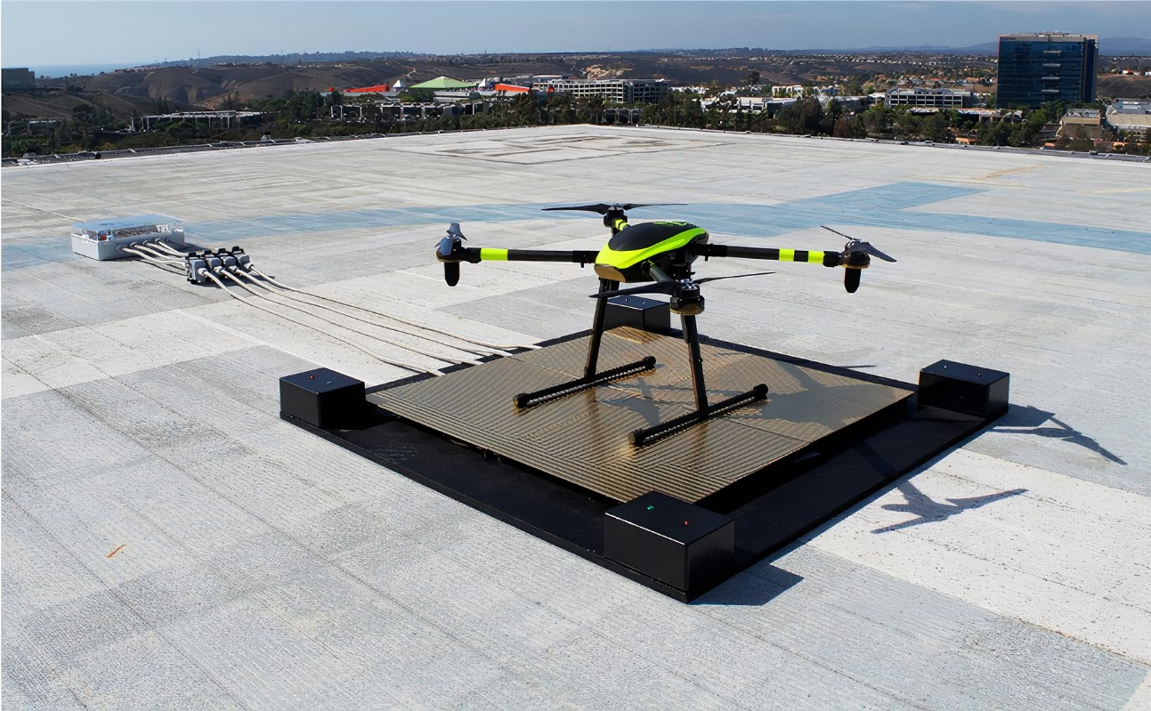
Return and Recharge
Drones returns to the nearest station for recharging or next delivery .
Battery replacement or recharge as needed.
Regular maintenance checks and update to ensure optimal performance.

Slide 9
Regulatory Compliance and Safety:
Compliance with local aviation and regulations.
Permissions and licenses for drone operations.
Collision avoidance systems .
Emergency landing procedures.
Regular safety drill and training.

Slide 10
Cost Analysis
Initial cost per drone INR 130k.
Monthly maintenance INR 6.5k.
Battery replacement INR 13k every 3 months.
Overall a monthly expenses of a drone is 21666.67.
Monthly salary of a executive is 27375(assume 425 deliveries).
Annually cost break down of a drone is 260000.
Annually earning of a delivery executive is 376500.
Drone deliveries offers significant cost savings over time.

Slide 11
Efficiency and Service Quality
Average drone delivery time 12 min for up to 8 km.
Improved customer satisfaction with quicker service.
Drone unaffected by traffic and road conditions, more predictable delivery times.
Drone can operate continuously by with battery swaps and maintenance.
Higher delivery frequency compare to human operated vehicles.
Differentiates the brand in a competitive market.
Appeals to tech-savvy customers and enhance brand image.

Slide 12
Market and Competitive Advantages:
Early adoption of drone technology sets the brand apart.
Attracts media attention and customer interest.
Faster, reliable deliveries foster customer loyalty.
Positive experiences lead to repeat businesses and word of mouth promotion.
Electric drone reduce carbon footprint.
Appeals to environmentally conscious customer.

Slide 13
Strategic Implementation
Pilot programs in high demand cities: Bangalore, Hyderabad, Delhi NCR.
Expand based on performance and customer feedback.
Partner with drone technology company.
Invest in infrastructure like charging station and secure landing zones.
Plant drone tower in high demand areas which help to reduce delivery times.
Make moveable Drone station or implant station in a van.
Invest to advance the drone technology and management system.
Educate customers on the benefits and reliability of a drone delivery.
Address concerns proactively through communications and promotions.

Slide 14
Conclusion
Drone delivery offers significant financial and service advantages.
Continued investment in drone technology and strategic implementation, leading the future of on-demand delivery services.
It helps to increase customers usage, average value of order and expand customer base.
We can use this delivery model in grocery delivery(instamart),and package delivery(Genie).
Due to this delivery model restaurant’s businesses got depend on our company it helps to get more commission from them.
Our advertisement services also get boost.

